Slide 1
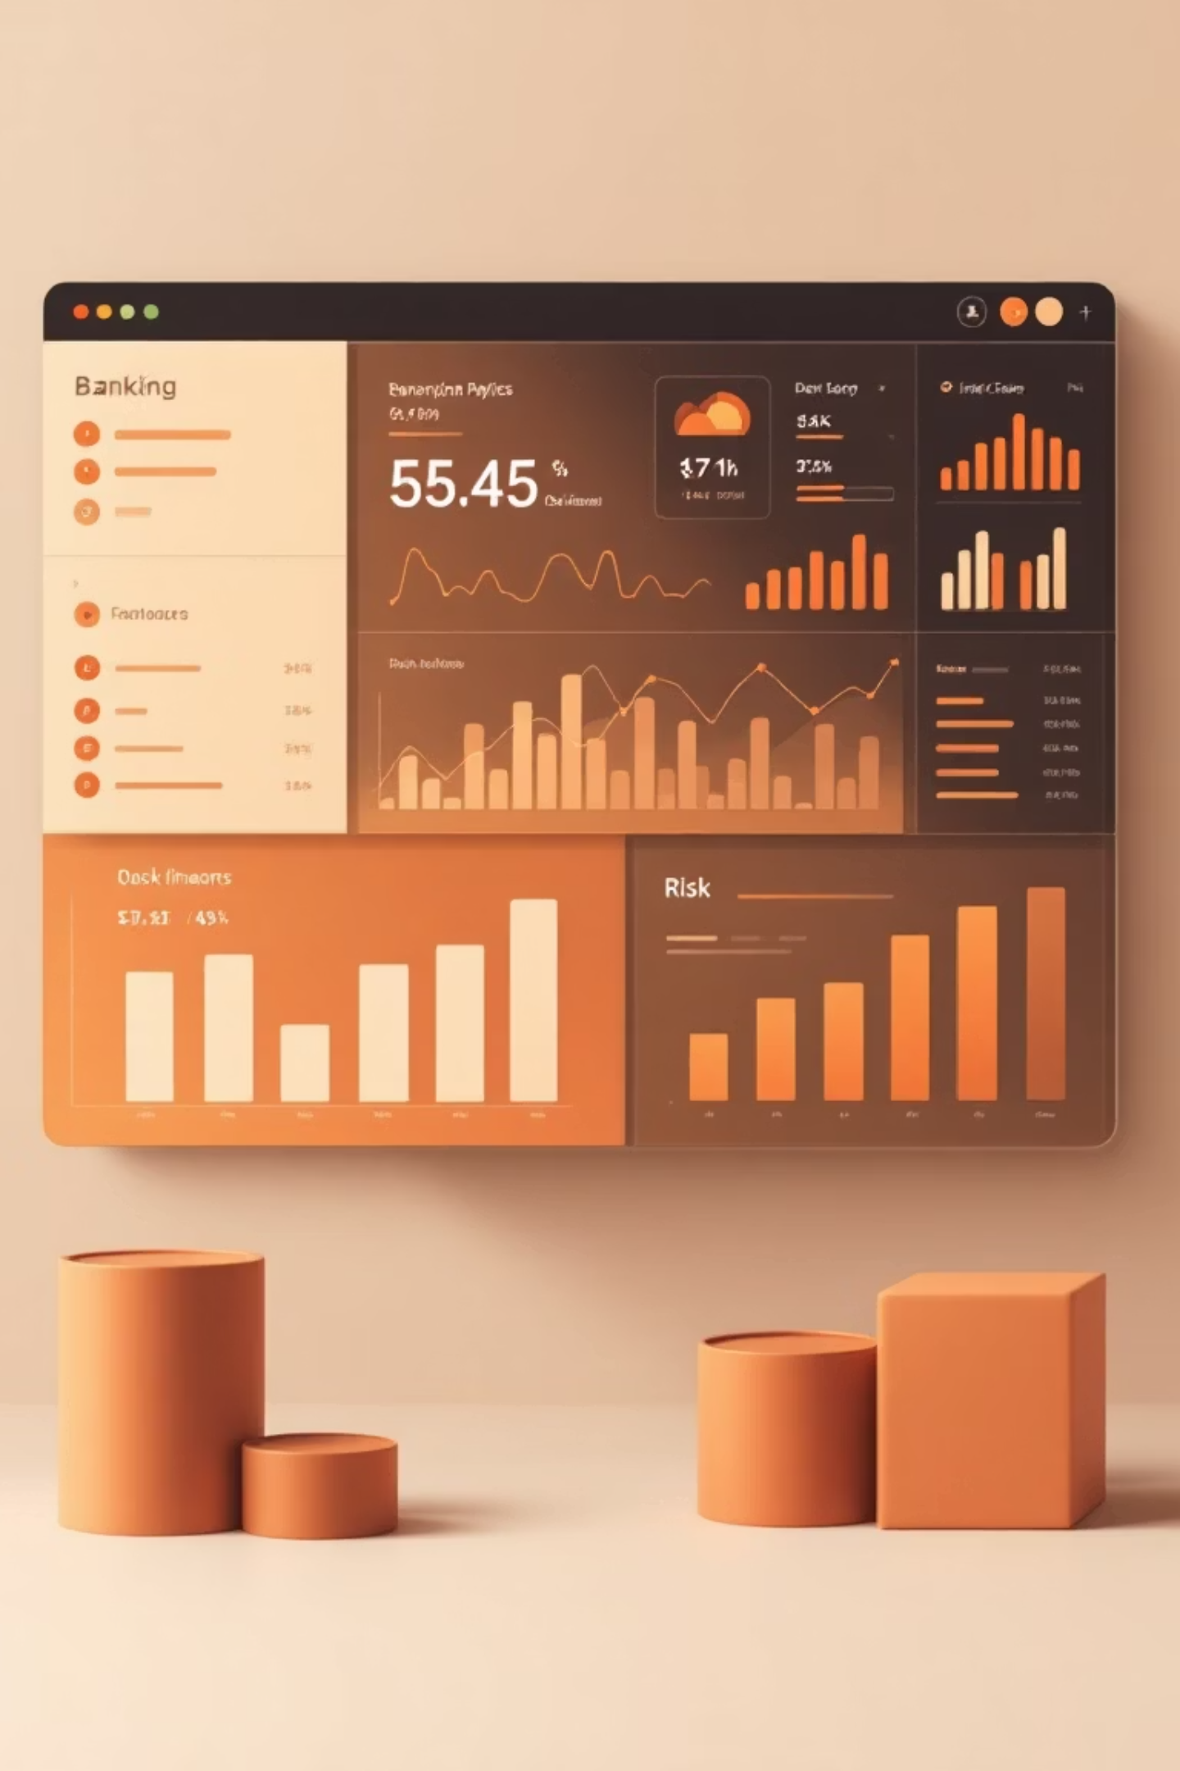
Risk Analytics in Banking: Identifying High-Risk Customers Through Financial Behaviour Analysis
A Data-Driven Approach to Minimize Lending Risk
Prepared by: Tarun Kale (Data Analyst)
View Interactive Dashboard

Slide 2
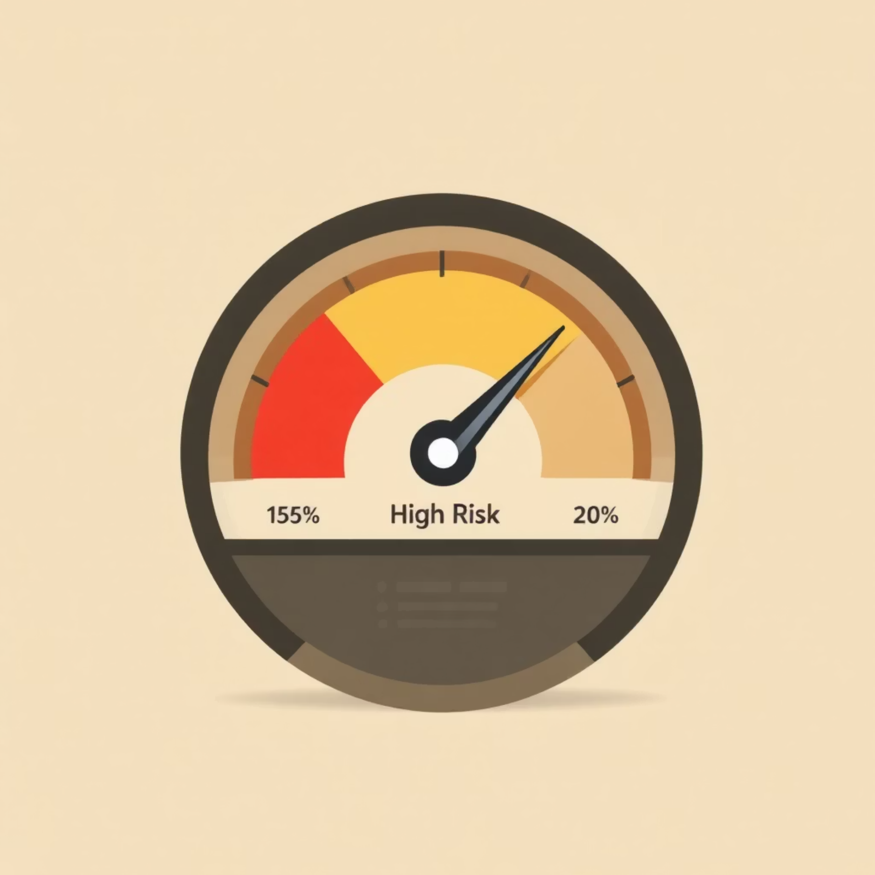
Business Problem
Why This Analysis Matters
Banks face continuous financial risk when lending to customers. Poor credit decisions can lead to loan defaults, impacting profitability and overall asset quality.
Core Business Problem
Banks need to identify customers who may default or delay payments
Traditional assessment methods are slow and less accurate
Rising credit card usage and multiple loan products increase risk complexity
Incorrect risk classification can result in major financial losses
What This Project Solves
Uses customer financial behaviour to detect high-risk patterns
Helps the bank make smarter, data-driven lending decisions
Improves credit approval accuracy and reduces potential losses
Supports building a more effective risk strategy

Slide 3

Dataset Overview
The project uses a structured banking dataset containing 5,000 customer records and 25 features, capturing a complete financial and demographic profile of each customer. The dataset is designed to support risk evaluation and lending decisions.
Identifier Fields
Demographic Attributes
Financial Indicators
Client ID, Name, Location ID, IAid, BRId
Age, Nationality, Occupation, GenderId
Estimated Income, Bank Deposits, Superannuation, Savings, Bank Loans, Business Lending, Credit Card Balance
Used for uniqueness and relationships; excluded from analysis
Helps understand customer behaviour patterns across groups
Used extensively to evaluate lending risk
Behavioural Metrics
Target Variable
Amount of Credit Cards, Checking & Saving Accounts, Loyalty Classification, Foreign Currency Account
Risk Weighting (High / Medium / Low)
This variable is the core output used for identifying risky customers
Shows customer engagement and money flow
This dataset provides a complete 360° view of each customer's financial health, making it ideal for understanding lending risk, identifying default-prone segments, and building risk mitigation strategies.

Slide 4
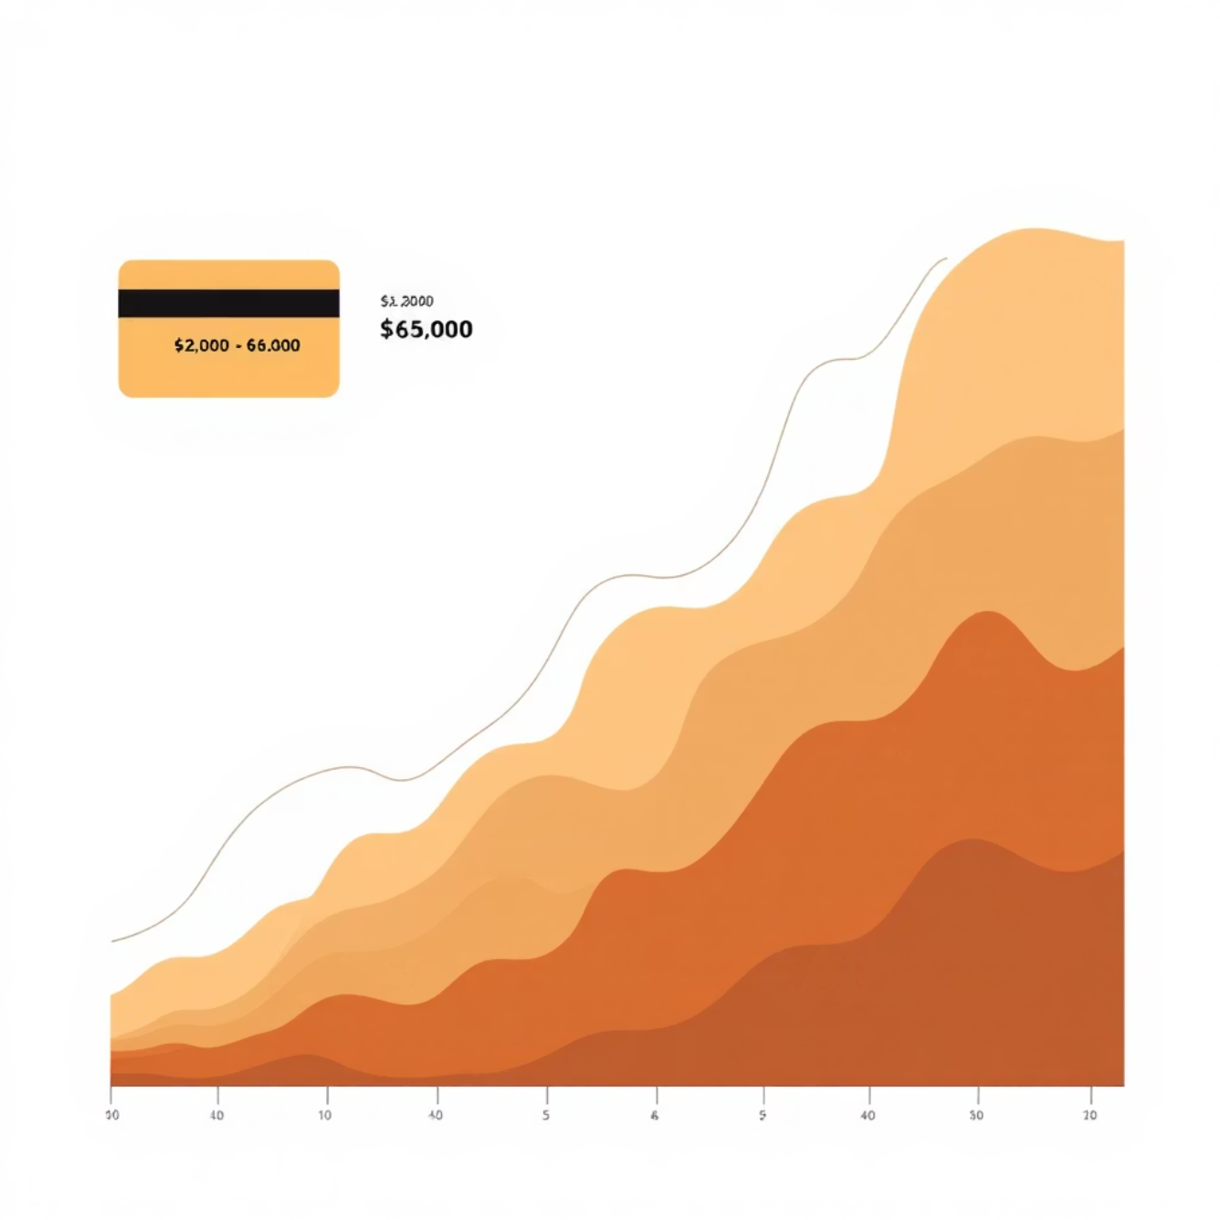
Overall Customer Risk & Financial Overview
5000
2.8
$4.2K
Total Customers
Average Risk Score
Avg Credit Balance
Complete customer portfolio analyzed
Moderate risk level across base
Typical customer credit exposure
Risk Category Distribution
A large share of customers fall under the Safe category, indicating a relatively stable portfolio. The Average Risk Score remains moderate across the customer base, with minor variation between demographic groups.
A significant trend appears in Credit Card Balance, where most customers hold balances between $2,000 and $6,000, showing a strong middle-range concentration.

Slide 5






Customer Risk & Financial Trends by Gender
When filtering by Gender, the portfolio remains consistent across Male and Female groups, with minimal variation in risk patterns and financial behavior.
41%
40%
40.1%
Male - Safe Category
Female - Safe Category
Combined - Safe Category
Key Findings Across Gender
Income Band vs Risk
Occupation Impact
Credit Balance Pattern
Higher income → Higher Risk pattern consistent for both genders. Lower income → Lower Risk across the board.
Professional roles (Senior Analyst, Financial Analyst, Software roles) show similar high-risk patterns for both genders.
Most users across both genders hold balances in the 2K–6K range, with very few above 10K.

Slide 6
Behavioral & Risk Trends by Age Band
Age analysis reveals consistent patterns across all age groups, with the Safe category dominating and credit card balances clustering in the 2K–6K range regardless of age.
Age 18–25
1
Safe: 38.08%
High Income Band shows higher risk. Professional & Other occupations show high risk scores.
2
Age 26–35
Safe: 40%
Age 36–50
3
Slight increase in safety. High income again shows higher risk. Similar occupation patterns.
Safe: 41%
Highest safety level. Income band follows same trend. Both Professional & Other remain highest in risk.
4
Age 51–65
Safe: ~40%
Age 65+
5
Pattern continues. "Other" occupation has slightly higher risk than "Professional".
Safe: ~40%
Similar risk and financial behavior. Balance range stays consistent across all metrics.
Across all age bands, the credit card balance distribution remains unchanged, with peaks consistently at 2K–6K, indicating stable spending patterns regardless of age.

Slide 7
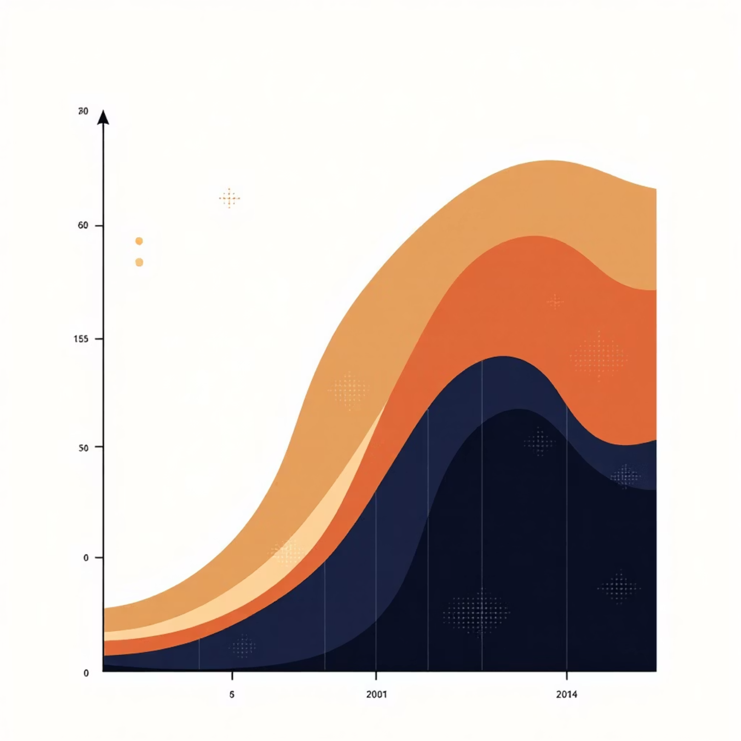
Risk Category Slicer – Behavioral Patterns
Balance Distribution by Risk Level
Safe & Very Safe: Customers hold 2K–4K balances, indicating low financial stress with tight clustering
Moderate Risk: Wider spread up to 10K, indicating emerging risk patterns
Risky & Very Risky: High variance with balances between 2K–12K, showing significant financial stress
85%
65%
45%
Safe Category
Moderate Risk
High Risk
Tight balance clustering 2K–4K
Wider spread up to 10K
Large variance 2K–12K
Across all risk categories, Other and Professional occupation groups consistently show higher average risk scores, regardless of the overall risk classification.

Slide 8
Income Band Impact on Risk Behavior
Income level significantly influences risk behavior, with high-income customers showing the highest proportion of moderate risk at 59.9%.
High Income
Medium Income
Low Income
Moderate Risk: 59.9% (highest share)
Safe: 47.97% (highest share)
Very Safe dominates
Slight spike in credit balances around 10K. Professional occupations dominate this segment.
"Other" occupation group shows higher risk in this band. Most balances remain 2K–10K.
Lowest risk profile overall. Tight clustering of balances in 2K–6K range.
Key Insight
Credit card balance patterns show most customers remain in the 2K–10K range regardless of income level, though high-income customers show a distinct spike around 10K.
Occupation groups behave similarly across income bands, with the exception of the "Other" group showing elevated risk specifically in the Medium income band.

Slide 9

Occupation Group – Customer Risk Profiling
All occupation groups show Safe as the dominant category (~40–41%), but Professional and Other groups consistently demonstrate higher average risk scores.
Admin
Other
Safe: ~40%
Safe: ~41%
Relatively stable, lower volatility. Most balances 2K–10K.
Highest risk averages. High income increases risk significantly.
Professional
Skilled
Safe: ~40%
Safe: ~41%
Highest risk averages. Strong correlation with high income.
Relatively stable, lower volatility. Consistent balance patterns.
Universal Pattern
High income within each occupational group increases risk, showing a positive correlation between income level and risk score. Credit card balance distribution remains consistent across all occupations, with most customers between 2K–10K.

Slide 10

Conclusion & Actionable Recommendations
Key Insights
40–41% of customers are consistently "Safe" across most age bands
High-income customers show a rise in moderate-risk levels (~59%)
Professional and Other occupations have higher risk regardless of age/income
Credit card balances mostly cluster in the 2K–10K range
Very few customers show extreme high balances (>12K)
Business Recommendations
01
02
03
Target High-Risk Segments
Credit Monitoring Program
Age-Based Marketing
Focus risk-mitigation policies on high-income and professional category customers who show elevated risk patterns.
Provide targeted financial advisory for customers above 10K credit balance to prevent defaults.
Create age-wise marketing plans because risk patterns change across age bands, requiring tailored approaches.
04
05
Moderate-Risk Engagement
Financial Education
Introduce credit monitoring offers for moderate-risk customers to prevent escalation to high-risk status.
Promote education-based programs for young customers (18–25) to maintain safe scores and build healthy financial habits.
The overall analysis shows that most customers fall in the low to moderate risk category, especially within the 2K–6K credit balance and 18–50 age group. Income level and occupation type significantly influence risk behavior, while gender shows minimal variation.

